Slide 1
Mining on Someone Else's Dime:
Mitigating Covert Mining Operations
in Clouds and Enterprises.
(RAID ‘2017)

Slide 2
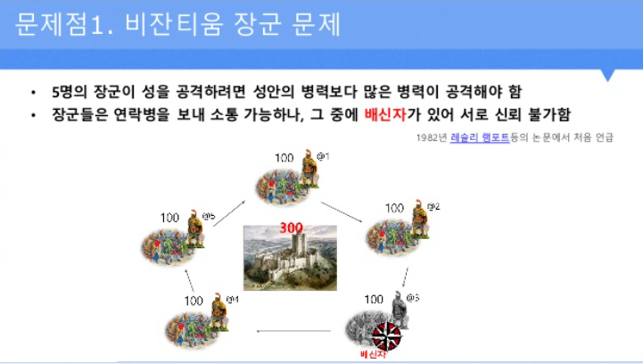
PoW (Proof of work) Algorithm

Slide 3
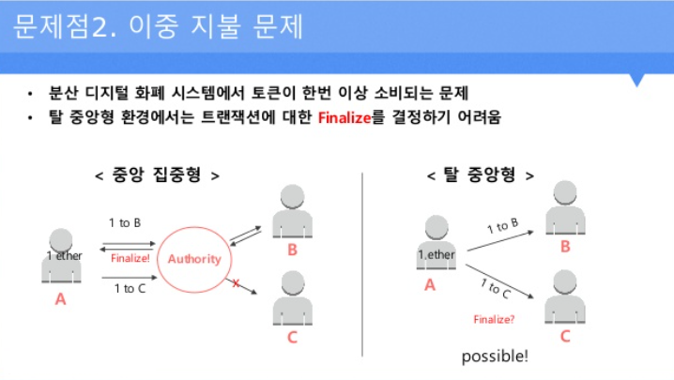
PoW (Proof of work) Algorithm

Slide 4
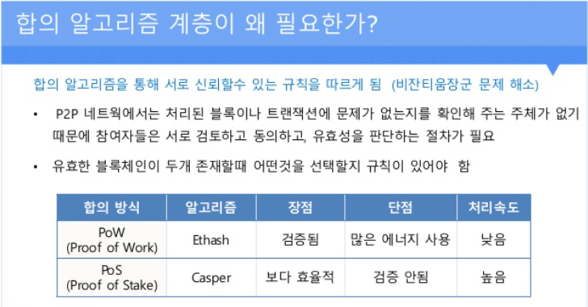
PoW (Proof of work) Algorithm

Slide 5
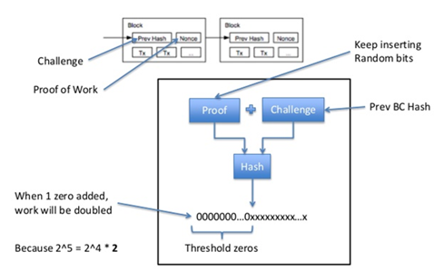
PoW (Proof of work) Algorithm

Slide 6
Abstract
* Covert cryptocurrency mining operations are causing notable losses to both cloud providers and enterprises.
* Mining results in increased power consumption, increased cooling and electricity costs due to the continued use of CPUs and GPUs.
*In this paper, we present MineGuard, a tool that can detect mining behavior in real-time across pools of mining VMs or processes, and prevent abuse despite an active adversary trying to bypass the defenses.

Slide 7
Introduction
* In this paper we present MineGuard, a simple hypervisor tool based on hardware-assisted behavioral monitoring, which accurately detects the signature of a miner.
* Specifically, our system uses Hardware Performance Counters (HPCs), a set of special-purpose registers built into modern processors, to accurately track low-level mining operations or events within the CPU and GPU with minimal overhead.
Notes:
구현원리 :하드웨어 성능 카운터(HPC)를 이용한 최소한의 오버헤드로CPU 및 GPU 내의저수준 마이닝 작업 , 이벤트를 포착

Slide 8
Introduction (2)
* Behavioral Analysis of Cryptomining:
1) CPU/GPU signatures of mining and non-mining applications differ substantially;
2) Different implementations of the same coin exhibit similar signatures due to the same underlying PoW algorithm
meaning that mining should be detectable by profiling an algorithm instead of the executing binaries
3) Profiles of various coins exhibit overlapping signatures, despite having different PoW algorithm
Notes:
따라서 실행바이너리가아닌 알고리즘을 파악해서 분석해야한다.

Slide 9
Understanding the Cost of Covert Cryptomining
1) They created a mine botnet by collecting free resources assigned to individual accounts such as dropboxes.
2) The mining botnet was capable of generating cryptocurrency worth thousands of dollars and went completely undetected, despite its large footprint and conspicuous behavior.
3) These covert and cleverly concealed mining operations are a serious financial concern for admins.
Notes:
( 이러한 무료자원을 이용한 봇넷이 있음에도 발견되지 않았다. 관리자들에게도 주요관심사로 급부상함. ( to maximize the hash rates hackers push CPUs/GPUs to full compute capacity for extended periods of time. )

Slide 10
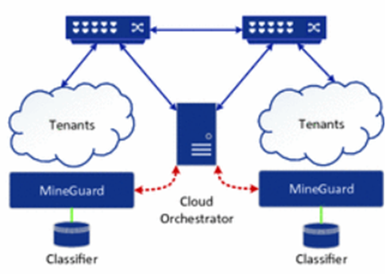
Design and Signature
* Profiler polls HPC at 2 second intervals to measure VM in real time
* Use a custom sampling frequency to increase accuracy. (Because the minors are long-term activities that run for at least a few hours)
1) Unlike malware that is used in a new way, Minor uses the pow algorithm based on password centrality.
2) Makes the attacker unaware whether or not to profile using VMs.
Notes:
2초마다 HPC간격을 측정해서 실시간으로 변화를 관측하고, 사용자 샘플주파수를 통해 정확도를 높인다. ( 충분히 샘플주파수를 바꿀수있는 이유는, 마이너는 최소 몇시간이상 돌려야하므로)
시그니처 데이터베이스를 이용, PoW 알고리즘을 고수해야하므로, 또한 이는 마이너가 다형성이나,

Slide 11
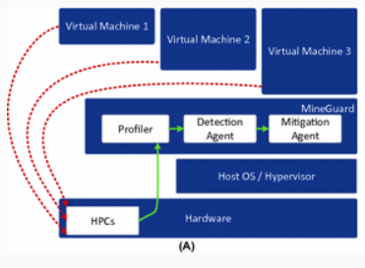
Signature Database
1) Unlike generic malware, miners have to stick to a core PoW algorithm. Whether the miner is polymorphic, metamorphic or heavily obfuscated, the core algorithm, which we profile in our system, remains the same.
2) Each signature in the database is distinct and prominent compared to other common cloud workloads
Notes:
일반적인 맬웨어와 달리 마이너는 핵심 Pow 알고리즘을 고수해야하고, 다형성, 난독화 여부와 관련없이 핵심알고리즘은 동일하게 유지된다. (HPC 관측하는 2초씩 폴링)

Slide 12
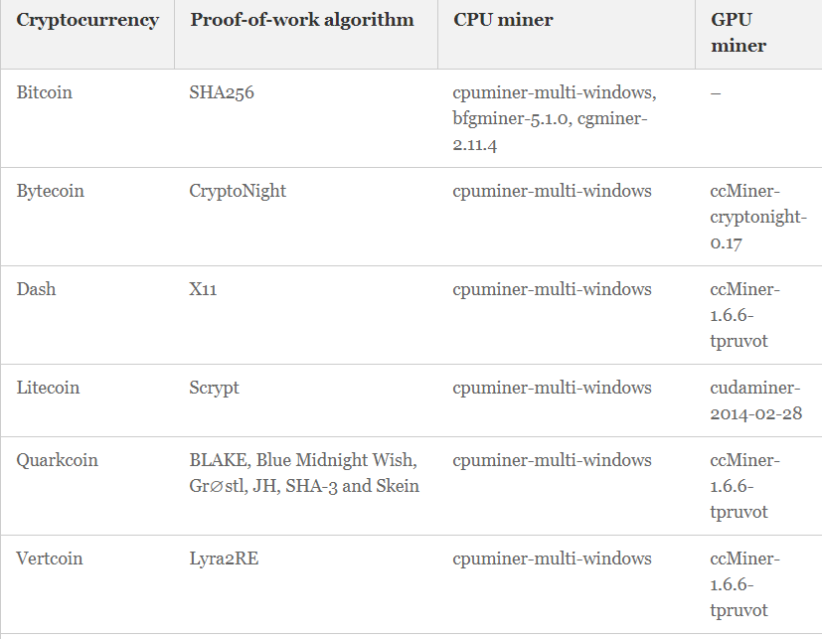
Mine guard implementation
1) Implement decision tree
for CPU,GPU Profiling by using KVM
2) Signature generation detection module : C++
3) Profile and Collect VM's Data : Bash , Python.
Testbed :
Notes:
일반적인 맬웨어와 달리 마이너는 핵심 Pow 알고리즘을 고수해야하고, 다형성, 난독화 여부와 관련없이 핵심알고리즘은 동일하게 유지된다. (HPC 관측하는 2초씩 폴링)

Slide 13
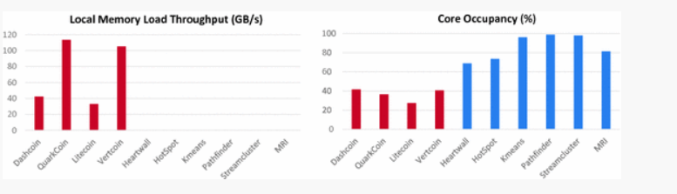
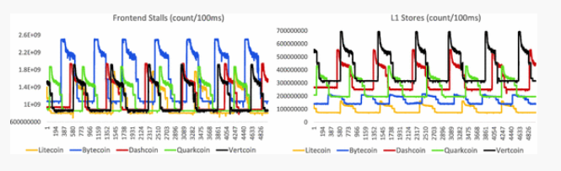
Evaluation
1) Difference in behavior GPU miners and GPU applications.
Miners are shown in red; applications are shown in blue.
2) Similarity in behavior of various cryptocurrencies (algorithms)
The reason behind this, as mentioned previously, is that at their core, all miners have to abide by a fixed PoW algorithm.
Notes:
일반적인 맬웨어와 달리 마이너는 핵심 Pow 알고리즘을 고수해야하고, 다형성, 난독화 여부와 관련없이 핵심알고리즘은 동일하게 유지된다. (HPC 관측하는 2초씩 폴링)

Slide 14
MineGuard Under an Active Adversary
In an attempt to throw off MineGuard,
a clever attacker could selectively create noise in the HPCs by running computations in parallel
that influence counters not involved in mining.
Practically 100 experiments with light coin
Modify patterns of certain HPCs that are irrelevant to the mining signature and appear as a benign workload to the classifier
Notes:
공격 가정상황 1. 마이너에 관여하지않는 카운터에 영향을 주는 계산을 병렬로 실행해 HPC를 방해하는 선택적 노이즈를 만들수있다. -> 이럴경우 HPC의 값을 인위적으로 늘리거나 패턴을 수정하여 양보하게된다.
-> 실제로 라이트코인으로 실행

Slide 15
Limitation
* First, they could employ known techniques of software obfuscation. However, since we target the algorithm and not the implementation, we believe that the attacker would have limited success
* Second, the attacker could artificially manipulate the counters by performing alternate computations that modify a
distinct set of counters orthgonal to the ones used in mining
* Thirdly, the attacker could attempt to stay under the radar and
mine at an extremely low hash rate. Theoretically, this is a
limitation since the attacker can evade MineGuard by sticking
to low hash rates.
Notes:
1.소프트웨어 난독화 기술 사용하기 ->공격자가 제한적인 성공을 거둔다 (여기서는 PoW 알고리즘 목표로함.)
2. 광산에서 사용되는 카운터와 직각인 카운터세트를 수정하는 대체계산 수행 ->>
3. 탐지되지못하는 낮은 해시비율을 유지해서 마인가드를 할수있다 -> 낮은비율은 어차피 원래리소스 남용문제가 없다고 생각한다.

